Slide 1
Lesson C
Memory Verses and Music
©NETworkers TEC – www.networkerstec.com

Slide 2
Luke 19:10
“For the Son of Man came to seek and to save the lost.”

Slide 3
Picking Your Material – Memory Verses
Relates to your theme.
A passage of Scripture and learn a new verse each week.
Gospel Centered

Slide 4
Picking Your Material – Memory Verses
d. Large quantities of Scripture.
e. Relates to the life of a child.

Slide 5
Picking Your Material – Music
A specific purpose.
Easy to sing.
Pick age appropriate songs.
Consider what type of accompaniment is best.

Slide 6
Meet Hermen/
Hummin
Hi!

Slide 7
Hermeneutics = To explain or interpret Scripture.
Exegesis = The “explanation of a text based on a careful, objective analysis… That means that the interpreter is led to his conclusions by following the text.”

Slide 8
Observation – What does it say?
Interpretation - What did the text say to the original audience?

Slide 9
Principalization - What is the principle for all time? What does it mean?
Application - How do I apply this text/principal?

Slide 10
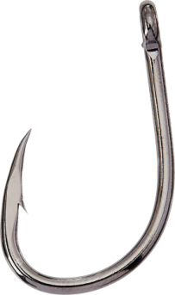
Eyes - Introduction
Brief intro that catches the child’s attention AND relates to the topic of the Bible verse.

Slide 11
Ask an open ended question.
Do a short object lesson/activity.
Show a picture/prop.
Tell a brief story that illustrates a related point.
Act it out/show a short video clip.

Slide 12
Ears - Presentation
Pre-mark and read the Bible verse OR sing/play the song.
Music Preparation.
Display.

Slide 13
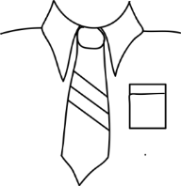
“We always thank God, the Father of our Lord Jesus Christ, when we pray for you.” Colossians 1:3 [ESV]

Slide 14
Ears - Presentation
d. Read the address of the verse at the beginning and at the end.
e. Present the Bible as the true, Word of God.

Slide 15
Brain - Explanation
神 爱 世 人.
Shen eye sure ren.
約 翰 福 音 三章:十六节
You han fu yin san zhang sure leo jay

Slide 16
For God so loved the world
神 爱 世 人.
Shen eye sure ren.
John 3:16
約 翰 福 音 三章:十六节
You han fu yin san zhang sure leo jay

Slide 17
Brain - Explanation
Explain/define difficult key words, phrases, or concepts.
Use practical examples.
Summarize the meaning.

Slide 18
Brain - Explanation
e. Explain the Bible verse address.
f. Explain the context of the verse.
g. Talk about the time period, context, and/or culture surrounding the verse.

Slide 19
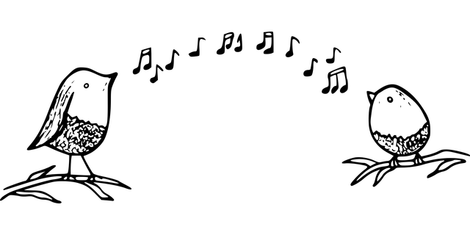
Brain - Explanation
h. Tell the history of the song or its author.

Slide 20
Heart - Application
For the Unsaved.
For the Saved.
Practical Example.
Challenge with follow up.

Slide 21
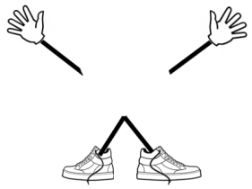
Hands and Feet - Repetition
Review the Bible verse 6-8 times with a fun activity.
Repeat a new song a couple of times.
Key actions.
Draw pictures.

Slide 22
Smile – Recitation
Take home sheet.
Review next class time and beyond.
Ask review questions.
Chart and reward memory work.

Slide 23
Smile – Recitation
e. Have a high standard for Scripture recitation.
f. Learn a new part each week.
g. Have the right heart attitude.

Slide 24
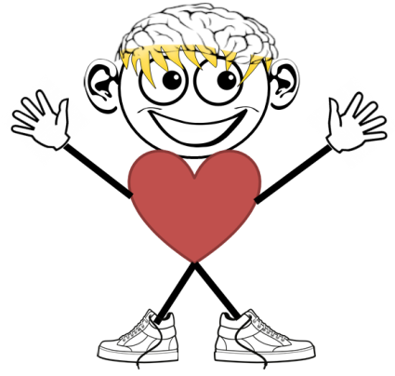
Luke 19:10

Slide 25
Luke 19:10
“For the Son of Man came to seek and to save the lost.” Luke 19:10

Slide 26
Meditation Keys
Memorize it.
Write it and put it somewhere where it can be seen often.
Repeat it aloud, at least once a day.

Slide 27
Meditation Keys
4. Set an alarm or get in the habit of saying it at a certain time of day.
5. Intentionally think about it before you go to bed.
6. Pray the verse.
Ask discovery questions about the verse and let God teach you, or research the answers.
Look up key words from the verse in a Bible dictionary or concordance.
Write down what God teaches you about the verse.
Share your insights with someone else.

Slide 28
Meditation Keys
7. Ask discovery questions about the verse and let God teach you, or research the answers.
8. Look up key words from the verse in a Bible dictionary or concordance.
Write down what God teaches you about the verse.
Share your insights with someone else.

Slide 29
Meditation Keys
9. Write down what God teaches you about the verse.
10. Share your insights with someone else.

